Slide 1
Can Explainable AI Techniques Explain Unfairness?
Kiana Alikhademi, Emma Drobina, Brianna Richardson

Slide 2
Objectives
Contribution
Define a rubric for evaluating XAI tools in terms of their use in evaluating fairness
Apply this rubric to three case studies: COMPAS, Hate Speech, Patient Survival rates
Developed holistic fairness rubrics with respect to the access and capabilities of XAI
Examine the state-of-the art fairness tools with respects to our comprehensive rubrics
Outline the gaps withins this area

Slide 3
Defining Fairness
Used the literature to distinguish major recurring issues of fairness involved in machine learning.
Distinguished four major areas of need:
Biased data & bias that are reflected in the data
Pre-processing procedures
Selection and optimization of ML models
Perception of ML results

Slide 4
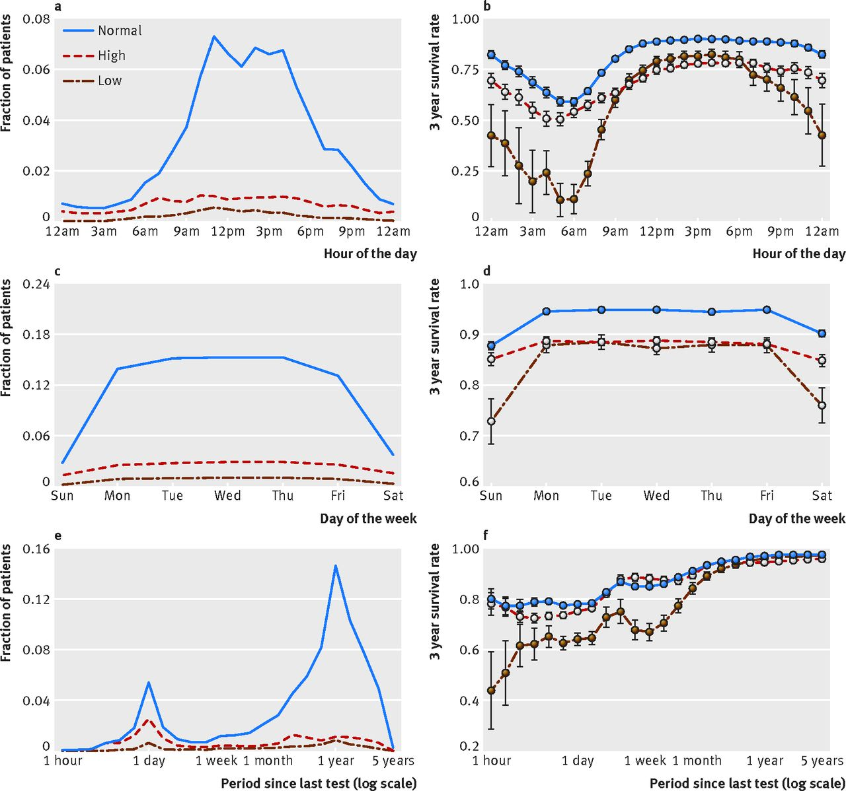
Health Data³
Patients had decreased survival rate when:
Tests run early in the morning, or
Tests ordered on the weekend, or
Consecutive tests ordered in shorter period of time
Healthcare processes could be a better predictor than actual lab values.
3. Agniel, D., Kohane, I. S., and Weber, G. M.Biases in electronic health record data due to processes within the healthcare system: retrospective observational study. BMJ 361(2018).

Slide 5
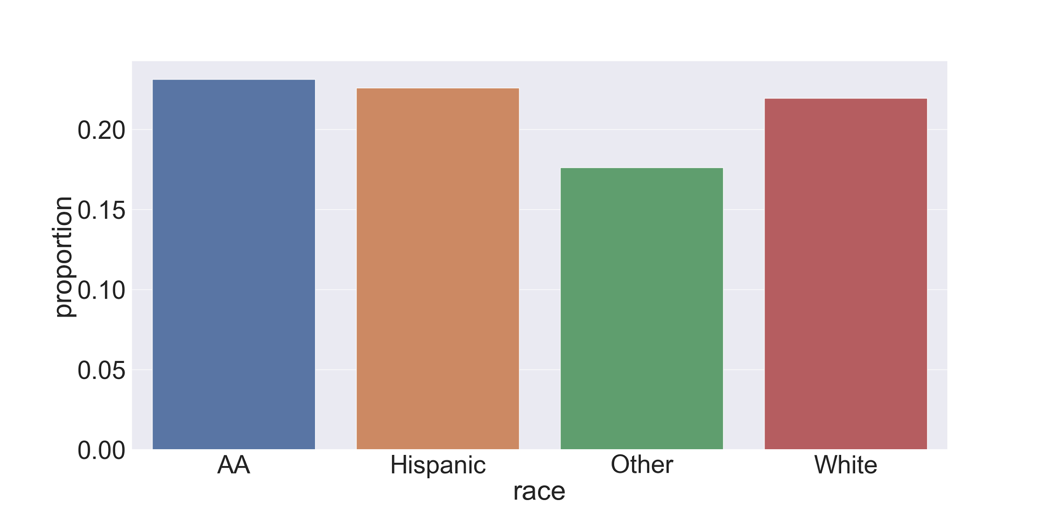
Twitter Data²
Based on previous research indicating racial bias in abusive language detection
Unique because we trained on data that did not include race & tested on data that did include race
Only slight differences in how our model classified different races
Proportion of derogatory tweets by race (for random forest classifier)
2. https://dataverse.mpi-sws.org/dataset.xhtml?persistentId=doi:10.5072/FK2/ZDTEMN

Slide 6
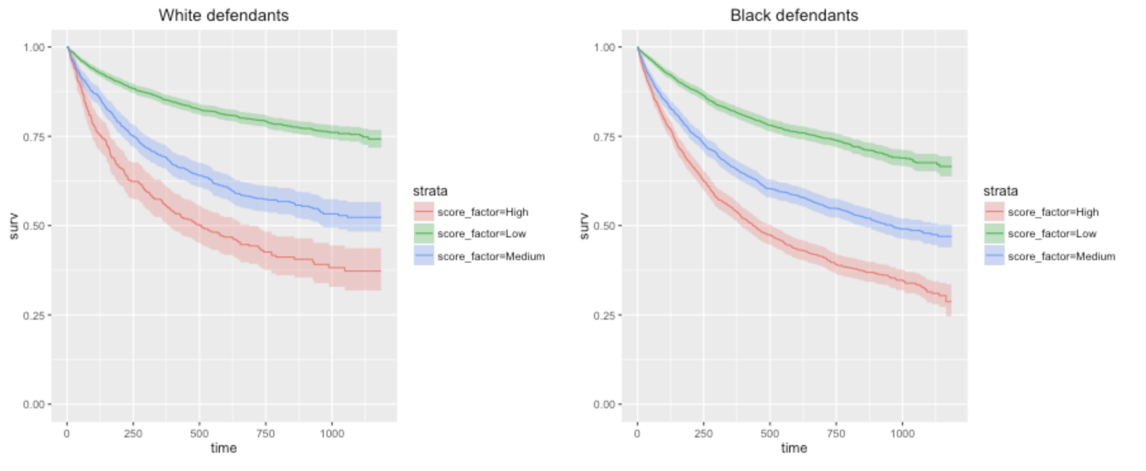
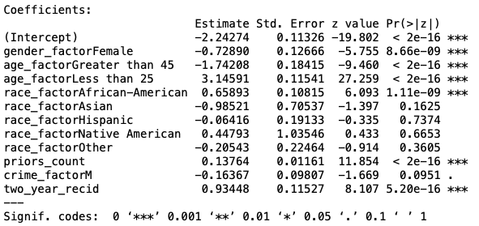
COMPAS Data¹
Black defendants do recidivate at higher rates according to race specific Kaplan Meier plots.
The violent score overpredicts recidivism for black defendants by 77.3% compared to white defendants.
https://github.com/propublica/compas-analysis/

Slide 7

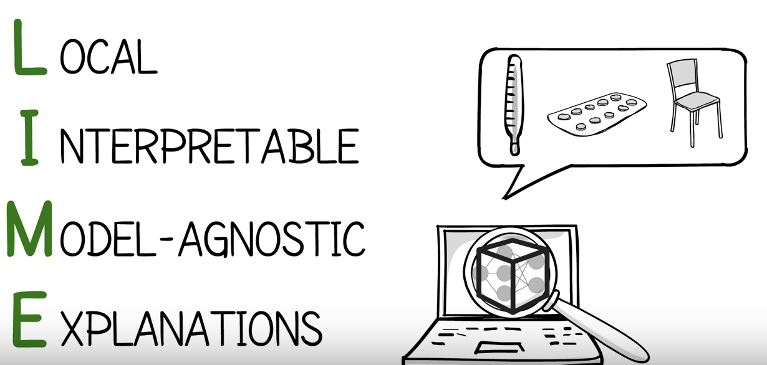
XAI Tools
Two explainable models
Random Forests
Logistic Regression
Explainable AI tools:
LIME [2][video]
AI Fairness 360(AIF 360) [1][video]

Slide 8
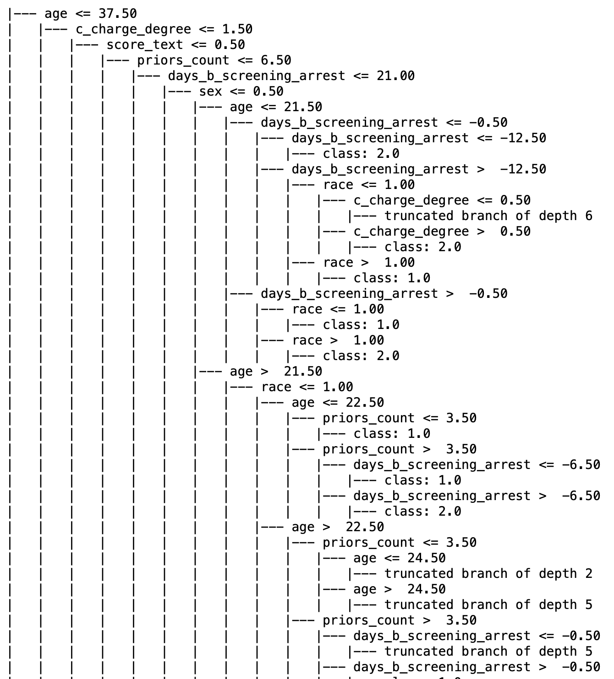
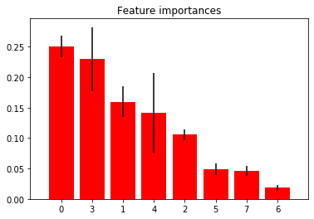
XAI Model Evaluation - Random Forests
Easy to implement
Needs additional processing to come up with presentation of explanations and feature importance
Notes:
Not sure what to get from this page

Slide 9
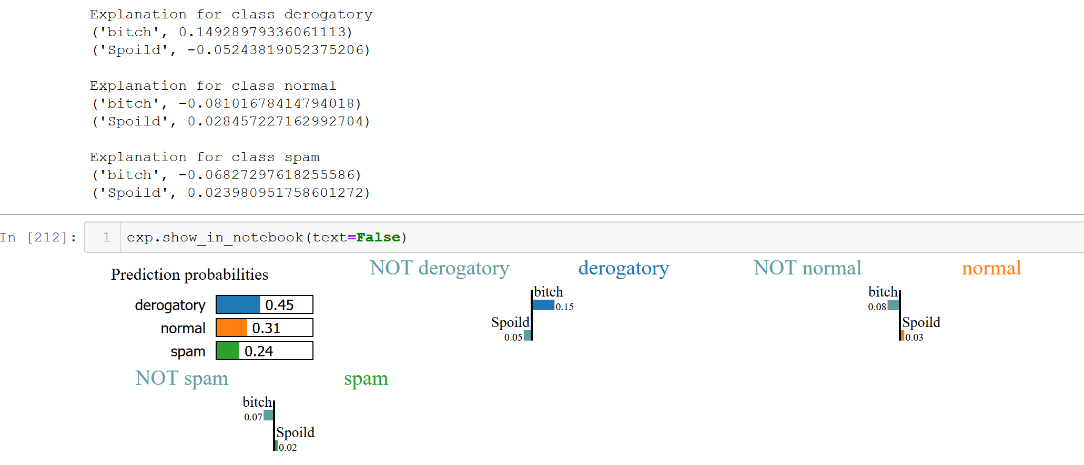
XAI Model Evaluation - LIME
Explains one sample at a time
To extract relevant fairness information, more processing needed!
Its lack of global awareness is a weakness, but it gives detailed information on why a sample belongs to a given class (output is similar to logistic regression)

Slide 10
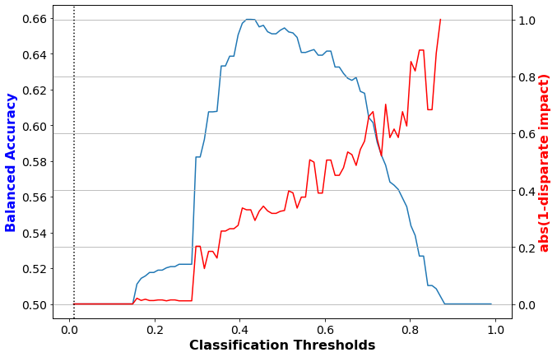
XAI Model Evaluation - AIF360
Considers the fairness and parity between user-determined unprivileged and privileged groups.
Looking into explanations across different subgroups.
Detects imbalanced data and bias

Slide 11
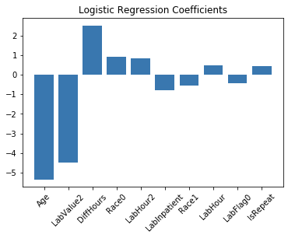
XAI Model Evaluation - Logistic Regression
Easy to understand
For fairness, requires additional processing!
What scores in each category associated to survival rates?
Are there disproportional representations of data?
Notes:
the results are easy to understand, but to get at fairness it requires additional processing (e.g. seeing what words are most correlated with what races & seeing if those words are disproportionately flagged)

Slide 12
Completed
Rubric
 | Random Forest | LIME | Fairness 360 | Ad-hoc explainability
Model used | Random Forest | Deep learning |  | Logistic Regression
Issues with Biased Data
Imbalanced data | 0 | 0 | 1 | 0
Influential variable identification | 1 | 1 | 0 | 1
Preprocessing issues | 0 | 0 | 1 | 0
Sensitive attributes | 0 | 0 | 1 | 0
Issues involved in Machine Learning Models
Model-Specific influences | 0 | 0 | 0 | 0
Accuracy equity | 0 | 1 | 1 | 0
Issues involved with XAI results
Target audience | 0 | 0 | 0 | 0
Presentation of explanations | 1 | 1 | 0 | 1

Slide 13
Conclusion/Future Work
Conclusion:
While current XAI tools have the data and the model, they still are lacking when it comes to a thorough investigation of issues involved in the results.
Future Work:
Incorporate WHATIF/AI Explainability 360
Develop a more detailed way to quantify the level of explainability each of these tools yield
Consider more sensitive attributes and how we can provide global explanations across all of them.

Slide 14
Citations
Bellamy, R.K., Dey, K., Hind, M., Hoffman, S.C., Houde, S., Kannan, K., Lohia, P., Martino, J., Mehta, S., Mojsilovic, A. and Nagar, S., 2018. AI fairness 360: An extensible toolkit for detecting, understanding, and mitigating unwanted algorithmic bias. arXiv preprint arXiv:1810.01943.
Tulio Ribeiro, M., Singh, S., & Guestrin, C. (2016). " Why Should I Trust You?": Explaining the Predictions of Any Classifier. arXiv preprint arXiv:1602.04938.
Agniel, D., Kohane, I. S., and Weber, G. M.Biases in electronic health record data due to processes within the healthcare system: retrospective observational study. BMJ 361(2018).

